Slide 1

Learn git
The most popular VcS

Slide 2
Clarify the relation
What is Git
Linus Torvalds created Git at 2005, as an open-source version control system
Distributed: every developer has complete codebase and history
What is Github
A website: for user to browse, to make change
A GUI software: Github desktop, as client to manage storage and sync with server
Non-linear workflows: thousands of parallel branches on different systems
A cloud service: storage of files, mostly codes
A CLI software: Github CLI, as client to manage storage and sync with server
Git is a software uses command line
There are other cloud service provider, like bitbucket, similar to github

Slide 3
Usage scenarios
Web UI, & cloud storage
Github Desktop (or CLI), & cloud storage
Git, & cloud storage
Suitable for simple file storage, and share with public
Suitable for team cooperation, program development
Other usage
With Git you can easily switch your cloud service provider
Use git to send code for deployment to production
Best for team development

Slide 4
One person one branch programming
After done your initial code, use the following:
PS> cd your_project_folder
PS> git init
PS> git add –A
PS> git commit –m “Initial commit”
PS>
Create local repo
Add file(s) to index
Commit changes to local repo

Slide 5
One person one branch programming
If you added new feature, or modify code to fix bug:
PS> cd your_project_folder
PS> git add –A
PS> git commit –m “fix XXXXX issue”
PS>
Add file(s) to index
Commit changes to local repo

Slide 6
One person one branch programming
If you want add label (version):
PS> cd your_project_folder
PS> git tag –a V1.0 –m “version 1.0 release”
PS> git show V1.0
PS> git tag –l “V1.*”
PS>

Slide 7
One person one branch programming
When you want share your code to the public: create a cloud repo with Github (or any other cloud service provider)
PS> cd your_project_folder
PS> git remote add origin https://github.com/your_account_name/your_remote_repo_name.git
PS> git branch –M main
PS> git push –u origin main
PS>
Add remote repo
Rename branch to main
Push to remote and set upstream tracking.

Slide 8
When new person B come join the development
Now we call the previous one person as PERSON A.
PERSON B would need a copy of the code, so that can start to work on it.
(B PS)> cd B’s_project_folder
(B PS)> git clone https://github.com/A_account_name/A_remote_repo_name.git
(B PS)>
Basically, git clone URL is like a combination of the following 4:
git init, git remote add origin URL, git fetch, git checkout

Slide 9
Team development
Now person A and person B is a team, and better do new develop on their own branch.
after tested ok, merge back to main.
(B PS)> cd B’s_project_folder
(B PS)> git checkout –b new_ui_update
(B PS)> ……
……
(B PS)> git commit –m “update for new ui”
(B PS)> git checkout main
(B PS)> git merge new_ui_update
(B PS)> git push origin main
If when B working on his branch, main maybe already updated by other person.
If this case merge would need solve conflicts. (files updated by both)

Slide 10
Team development
Another way of merging code.
(B PS)> cd B’s_project_folder
(B PS)> git checkout –b new_ui_update
(B PS)> ……
……
(B PS)> git commit –m “update for new ui”
(B PS)> git rebase origin main
(B PS)> git checkout main
(B PS)> git merge new_ui_update
(B PS)> git push origin main
Rebase will take what have been changed in main into the branch which is working on.
Need solve conflicts if main was changed by others.
After rebase, merge will be a simple forward, no conflicts.

Slide 11
Person A is in control of main branch
Many time that the program main branch was under control by specific person, or a small group of person.
After person B finish something, can send a request-pull to A, ask A to merge it to main.
(B PS)> cd B’s_project_folder
(B PS)> git checkout –b new_ui_update
(B PS)> ……
(B PS)> git commit –m “update for new ui”
(B PS)> git push origin new_ui_update
(B PS)> (request-pull normally done in specific ways, e.g. email. Github webpage have pull request)
B push his branch to remote repo. And ask A to pull them into main.
A pull B’s work into main after verified. After merge can push back to remote repo main
(A PS)> git checkout main
(A PS)> git pull origin new_ui_update
(A PS)> git push origin main
Basically is like a combination of : git pull origin, git merge origin/new_ui_update

Slide 12
Use git for deployment to production
Program after development, need consider how to deploy to production system.
Git can be used to deploy a Django webapp to Heroku cloud.
PS> heroku git:remote –a your_app_name_in_heroku
PS> git push Heroku main
Or if the production is stored in a sub-folder in you project
PS> git subtree push --prefix production_sub_folder heroku main

Slide 13
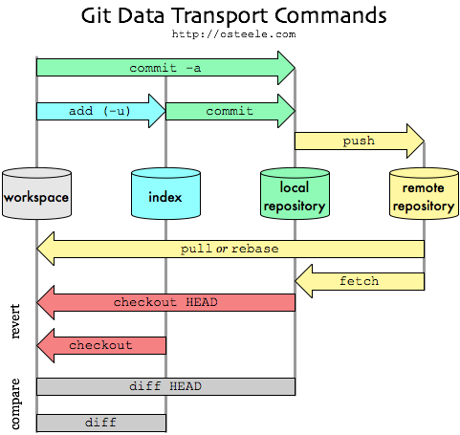
Git file transport concepts

